Slide 1
Project & Time Management
Joanna Buczkowska-McCumber
January 8, 2026

Slide 2
The Importance of Effective Planning
AGENDA
Getting to a 100
Your CRM
Project Planning Strategies

Slide 3
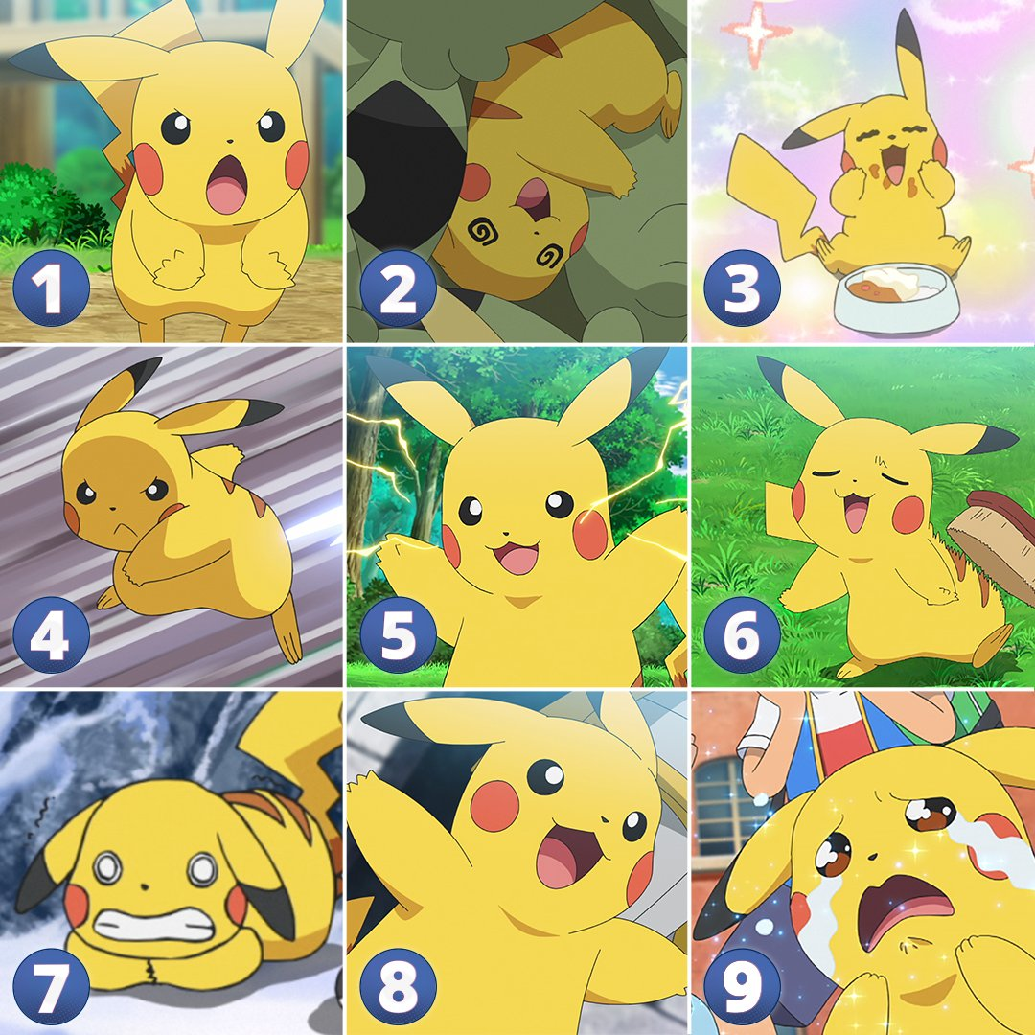

Slide 4


Joanna
Buczkowska-McCumber
Strategist, Problem Solver, Planner, Prioritizer
Making ideas and visions into tangible achievable goals through tactical strategy, planning, and implementation roadmaps.

Slide 5
The Importance of Effective Planning
Notes:
As always, let's start with a quick recap of last week's session

Slide 6
Key To Managing
Your Startup Journey
Notes:
https://jamesclear.com/continuous-improvement

Slide 7
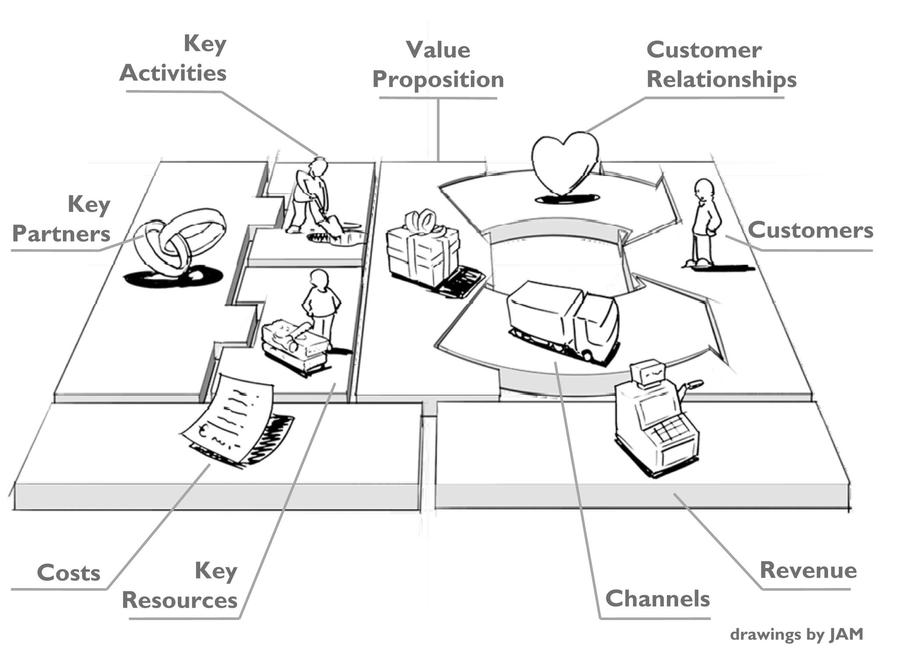
Notes:
https://jamesclear.com/continuous-improvement

Slide 8
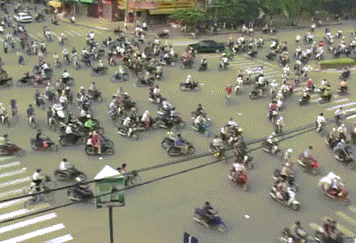
Notes:
Strictly speaking, fundraising is [read definition].
It's a simple concept
And who will provide the funding you need to succeed?

Slide 9

Chaos
Notes:
Strictly speaking, fundraising is [read definition].
It's a simple concept
And who will provide the funding you need to succeed?

Slide 10

Cost of Poor Time and
Project Management
Resource Wastage
Delayed Progress
Missed Opportunities
Overwhelm and Burn Out
On a startup level this has real impact including:
Poor Growth
Financial Loss
Closure

Slide 11
Key To Managing Your Startup Journey
One of the most conspicuous patterns we’ve seen among the thousand startups we’ve funded is that the most successful founders are always totally focused on their product and their users. To the point of being fanatical. The best founders don’t have time to get caught up in other things. - Jessica Livingston YC

Slide 12
Planning Matters in the Startup Journey
is not about predicting the future.
It is about deciding how progress will happen.
In early-stage startups:
Time, attention, and energy are limited
Uncertainty is high and answers are incomplete
Not all work moves the venture forward

Slide 13
Planning Matters in the Startup Journey
is not about predicting the future.
Planning matters because it:
Translates goals into concrete, repeatable action
Protects time for the work that actually creates evidence
Reduces wasted effort on activities that feel productive but don’t change decisions
Makes progress visible week over week
Enables adjustment when assumptions prove wrong

Slide 14
Key To Managing Your Startup Journey
Entrepreneurs who persistently pursue their GOALS without giving up are more likely to achieve lasting success.
Notes:
In the early stages of a startup, it's easy to get lost in a sea of possibilities
Setting clear goals gives your team a North Star to follow, reducing distractions and ensuring everyone is aligned.
When you know where you're headed, you can channel your energy and resources more effectively.

Slide 15
GOAL Setting
Goal setting is a process of identifying specific objectives that an individual or organization aims to achieve within a certain timeframe. It involves determining what you want to accomplish and establishing measurable goals and timeframes to guide your actions.
Make your Goals > SMART Goals
Understand the 'Why'
Break Down Large Goals
Incorporate Feedback and Accountability Mechanisms
Stay Flexible and Adapt
Consistent Tracking and Evaluation
Notes:
Make your Goals > SMART Goals
Understand the 'Why'> Clearly understand and articulate why each goal is important. This understanding fuels motivation and persistence, especially during challenging times.
Break Down Large Goals> Large goals can be overwhelming. Break them into smaller, more manageable tasks. This makes it easier to start taking action and track progress.
Incorporate Feedback Mechanisms> Establish ways to receive feedback on your progress. This could be through self-assessment, peer reviews, or regular check-ins if it's in an organizational context.
Stay Flexible and Adapt> Be ready to adjust your goals as circumstances change. Flexibility is key to staying relevant and realistic in your goal-setting process.
Consistent Tracking and Evaluation> Regularly monitor and evaluate your progress towards your goals. This tracking helps in identifying areas where you are excelling and areas that require more focus or adjustment.

Slide 16
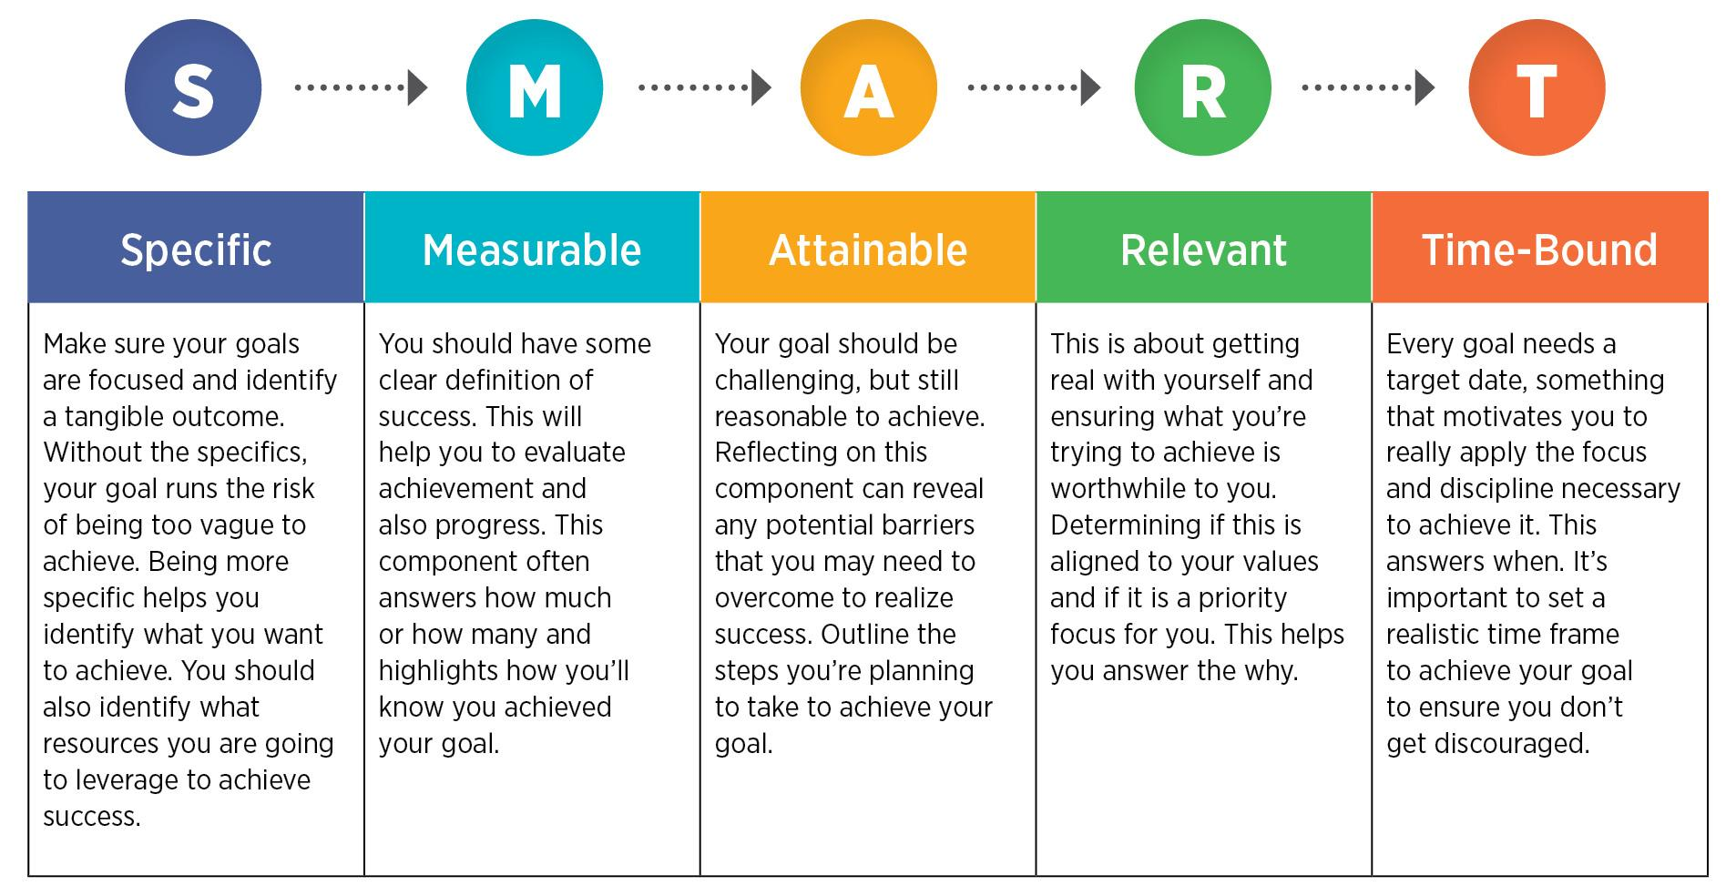
SMART GOALS
Notes:
[Read slide]

Slide 17
Questions to Ask Yourself
What is my goal in the program?

Slide 18
Questions to Ask Yourself
What is my goal in the program? Why does it matter?

Slide 19
Questions to Ask Yourself
What is my goal in the program? Why does it matter?
What does success look like?

Slide 20
Getting to a 100
Notes:
As always, let's start with a quick recap of last week's session

Slide 21

Notes:
https://jamesclear.com/continuous-improvement

Slide 22
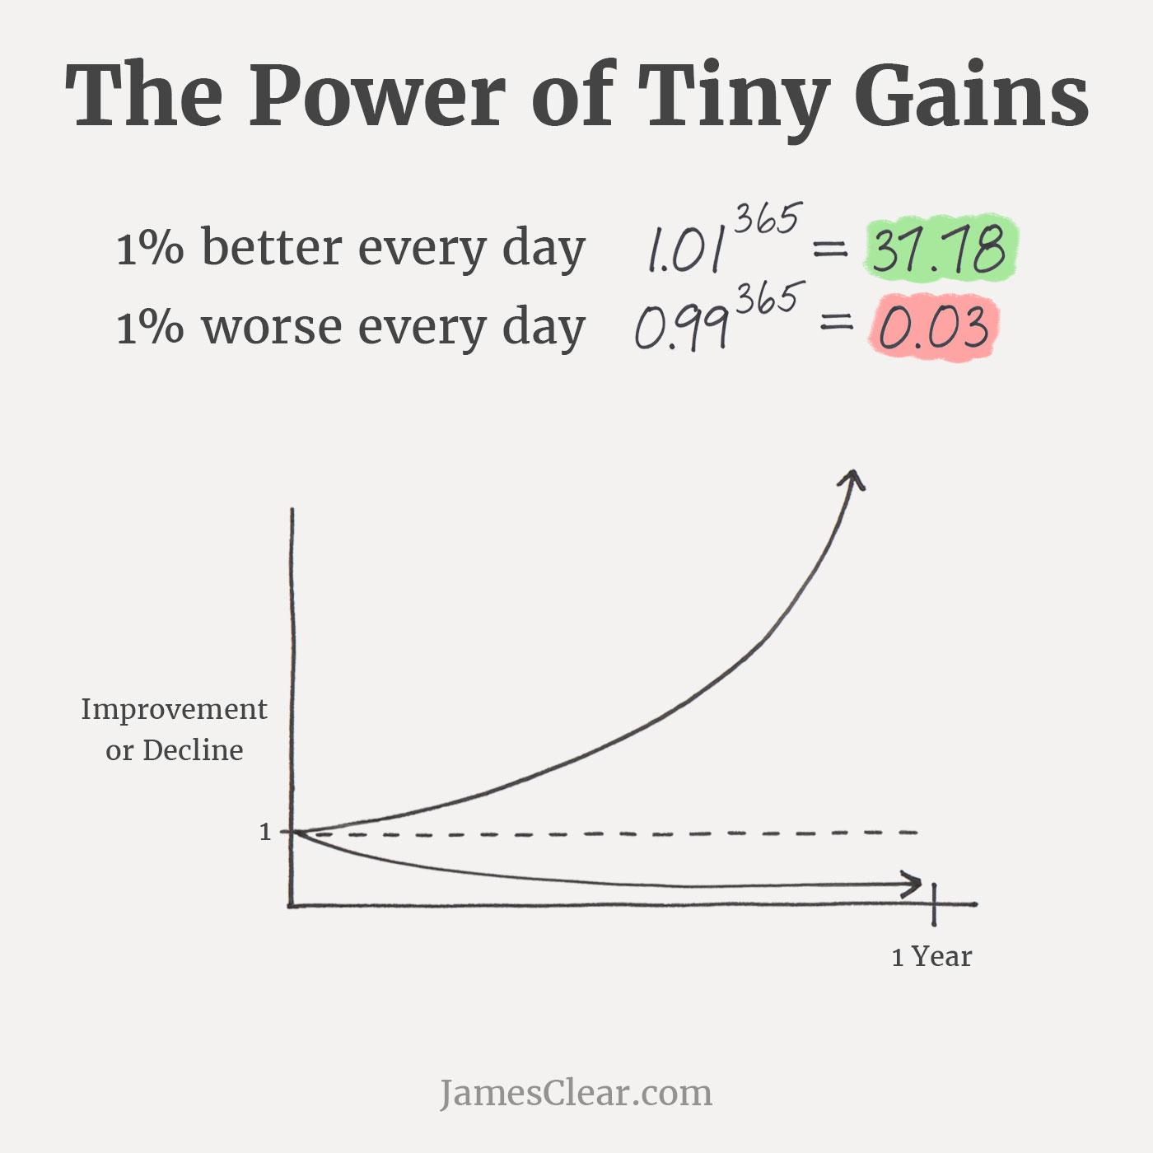
Key To Managing
Your Startup Journey
Notes:
https://jamesclear.com/continuous-improvement

Slide 23
Questions to Ask Yourself
Where are my prospects coming from?

Slide 24
Questions to Ask Yourself
Where are my prospects coming from?
How many do I need to reach out to to reach my desired outcomes?
How will I know I have validated a hypothesis in the b model?
Why am I doing this interview
What questions do I need to be asking?

Slide 25
Design the 100-Interview Execution Plan
Total interview target | 100
Planned timeframe | ___ weeks
Weekly interview target | ___ interviews / week
Primary stakeholder focus | Specific roles / users
Primary outreach channel(s) | (i.e. Linkedin, email, conferences)
Outreach happens on | Day(s) + time(s)
Interviews happen on | Day(s) + time(s)
Insights logged | ___ hours of interview _____ insight
Weekly synthesis/Review | Day + time
Daily “no-zero” action | Smallest action that keeps momentum
Adjustment trigger | What changes for next week?

Slide 26
Design the 100-Interview Execution Plan
Week | Outreach Sent | Interviews Completed | Cumulative Interviews | % of Weekly Target | Response Rate % | Key Insight / Pattern | Adjustment for Next Week
Week 1 | ___ | ___ | ___ | ___ % | ___ % | ___ | ___
Week 2 | ___ | ___ | ___ | ___ % | ___ % | ___ | ___
Week 3 | ___ | ___ | ___ | ___ % | ___ % | ___ | ___
Week 4 | ___ | ___ | ___ | ___ % | ___ % | ___ | ___
Week 5 | ___ | ___ | ___ | ___ % | ___ % | ___ | ___
Week 6 | ___ | ___ | ___ | ___ % | ___ % | ___ | ___
Week 7 | ___ | ___ | ___ | ___ % | ___ % | ___ | ___

Slide 27
NUMBER OF INTERVIEWS
 | How many people have you contacted? | How many people have answered you? | Calculate your response rate (%) | Number of interviews completed | Number of interviews scheduled but not yet completed | Number of references obtained
New Interviews (since the last sprint)
TOTAL =

Slide 28
Project Planning Strategies
Notes:
As always, let's start with a quick recap of last week's session

Slide 29
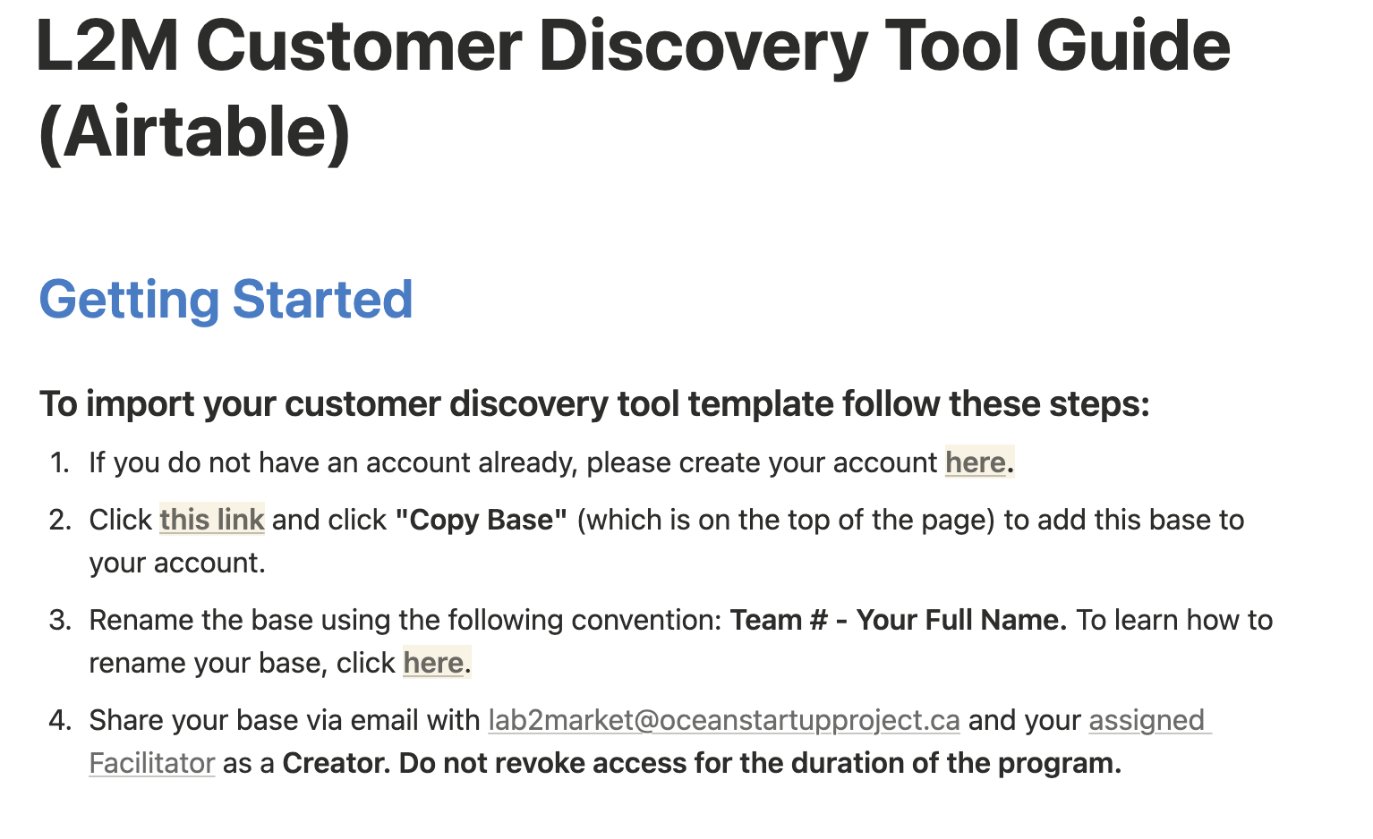
YOUR CRM
Prospects, Outreach, Interviews, Outcomes
Hypothesis, Experiments, Validation
Aha Moments, Learnings, Trends

Slide 30
What tools do you use to manage your time? Your workload? Your projects?

Slide 31



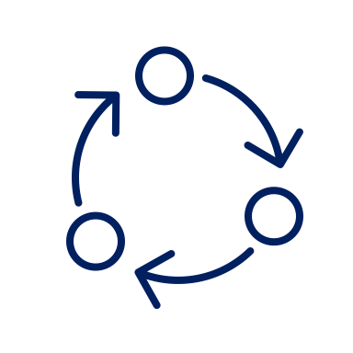
Project Planning
Planning
Execution
Monitoring
Closure
Clearly define Goals .
Determine the boundaries of the project
Identify and allocate the necessary resources
Develop a detailed project schedule that outlines the sequence of tasks, milestones, and deadlines.
Identify potential risks and uncertainties.
Assign roles and responsibilities.
Regular meetings and status updates.
Implement quality control.
Identify and address issues and challenges.
Define key performance indicators (KPIs) to measure project success.
Develop a change management process to handle any requested changes
Be prepared to adapt to unforeseen challenges.
Keep stakeholders informed.
Ensure that all project deliverables have been completed and meet the required quality standards.
Compile project documentation, including lessons learned, best practices, and any relevant project artifacts.
Conduct a comprehensive post-project evaluation to assess project success and areas for improvement.
Acknowledge and celebrate the achievements of the project team.
31
Notes:
Project management, we're essentially talking about a structured approach to completing tasks and achieving goals. And this structured approach can be broken down into four essential components.

Slide 32
Project Planning Tools
Critical Path Analysis This takes a complicated project and finds the most efficient path through it.
Brainstorming can be looked at as the plan before the plan. A plan for anything is a way to organize an approach. Brainstorming is a tool that uses the collective experience and skills of the project team in order to give project managers the full picture before they attempt to frame it in a plan.
Work Breakdown Structure (WBS) is a way to rank tasks in the project. Begin with the project, then start breaking it down: first into phases and then from those milestones, into tasks. In a sense, you’re starting at the end of the project and working backwards. The breakdown is considering the size of the task, how long it will take and who will be responsible for that task.
Gantt Chart The old standby for project planning is the Gantt chart. For decades, the Gantt chart has been included in the feature set of a slew of project management software platforms, which has given it a flexibility that emphasizes its many positive attributes.
Cause and Effect Diagram(or Fishbone Diagram) It gathers and identifies issues that can develop over the course of a project. There is risk inherent in every project, and planning against those risks is another way to make sure the project proceeds as planned, without costly interruptions.
32
Notes:
Project management, we're essentially talking about a structured approach to completing tasks and achieving goals. And this structured approach can be broken down into four essential components.

Slide 33
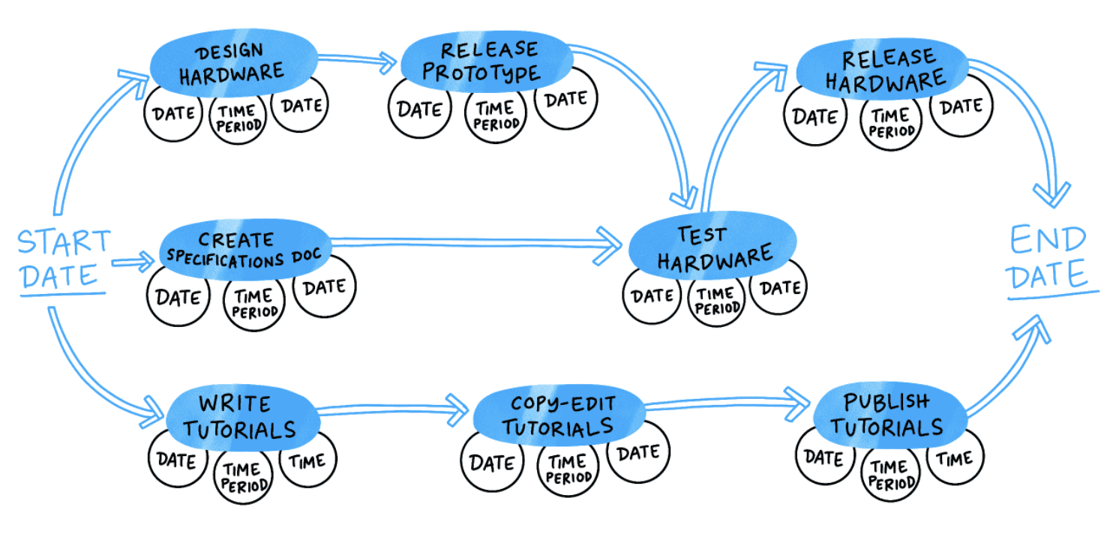
Project Planning Tools
Critical Path Analysis This takes a complicated project and finds the most efficient path through it.
33
Notes:
Project management, we're essentially talking about a structured approach to completing tasks and achieving goals. And this structured approach can be broken down into four essential components.

Slide 34
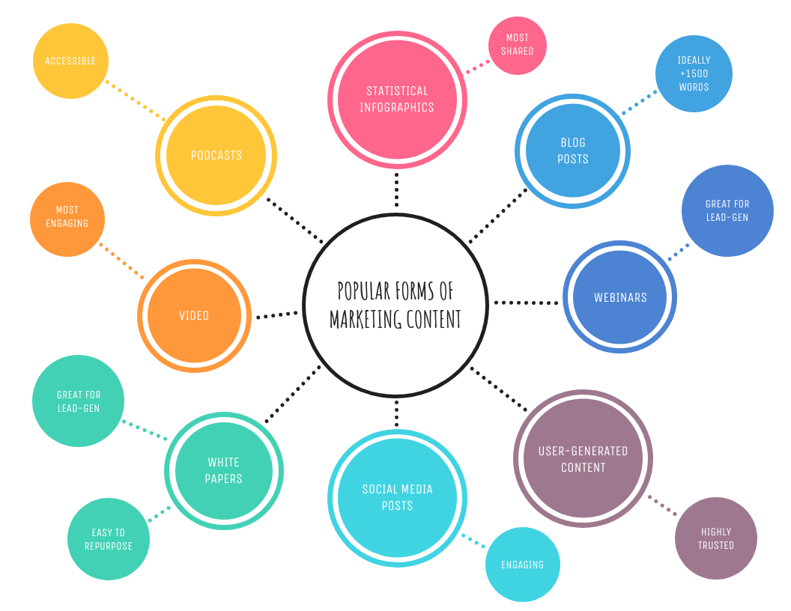
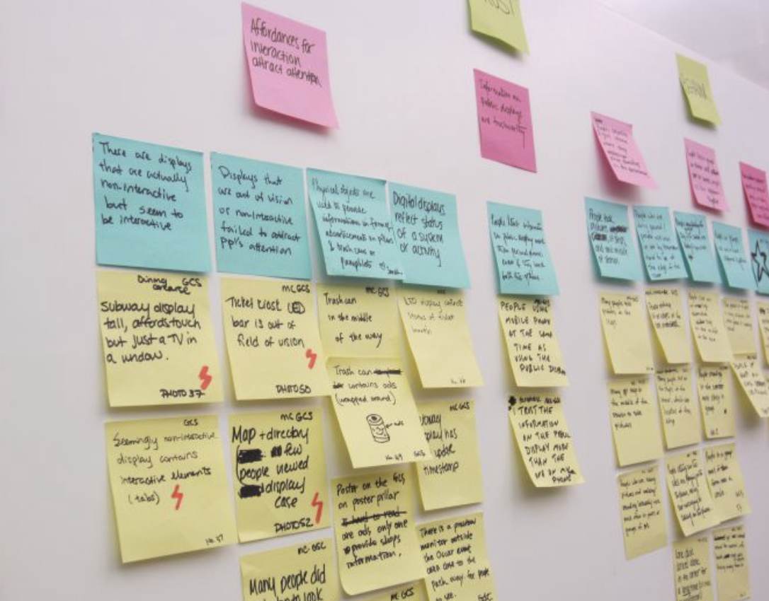
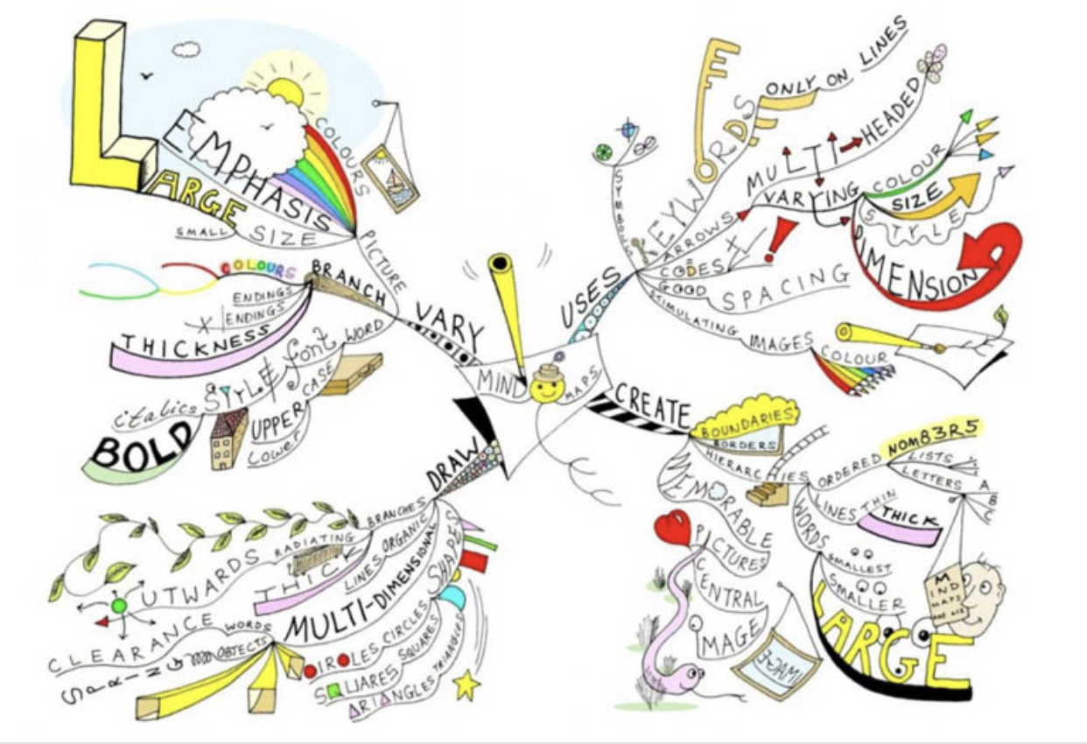
Project Planning Tools
Brainstorming can be looked at as the plan before the plan. A plan for anything is a way to organize an approach. Brainstorming is a tool that uses the collective experience and skills of the project team in order to give project managers the full picture before they attempt to frame it in a plan.
Without leaps of imagination or dreaming, we lose the excitement of possibilities. Dreaming, after all is a form of planning. – Gloria Steinem
34
Notes:
Project management, we're essentially talking about a structured approach to completing tasks and achieving goals. And this structured approach can be broken down into four essential components.

Slide 35
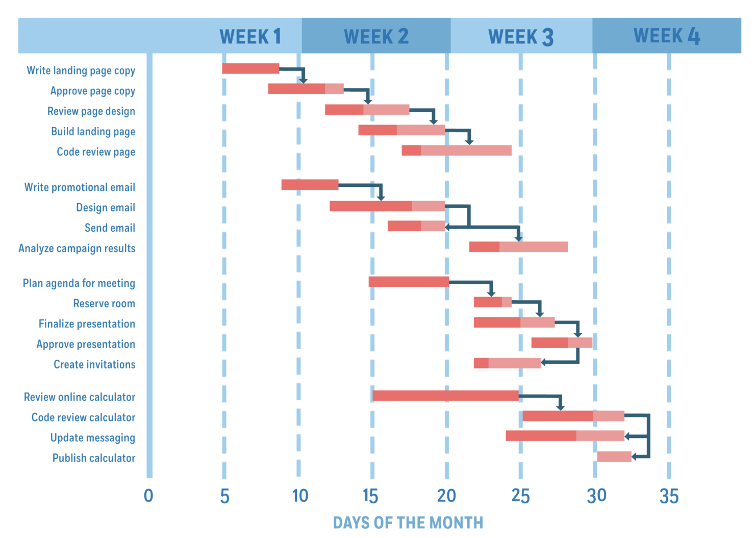
Gantt Chart The old standby for project planning is the Gantt chart. For decades, the Gantt chart has been included in the feature set of a slew of project management software platforms, which has given it a flexibility that emphasizes its many positive attributes.
Project Planning Tools
35
Notes:
Project management, we're essentially talking about a structured approach to completing tasks and achieving goals. And this structured approach can be broken down into four essential components.

Slide 36
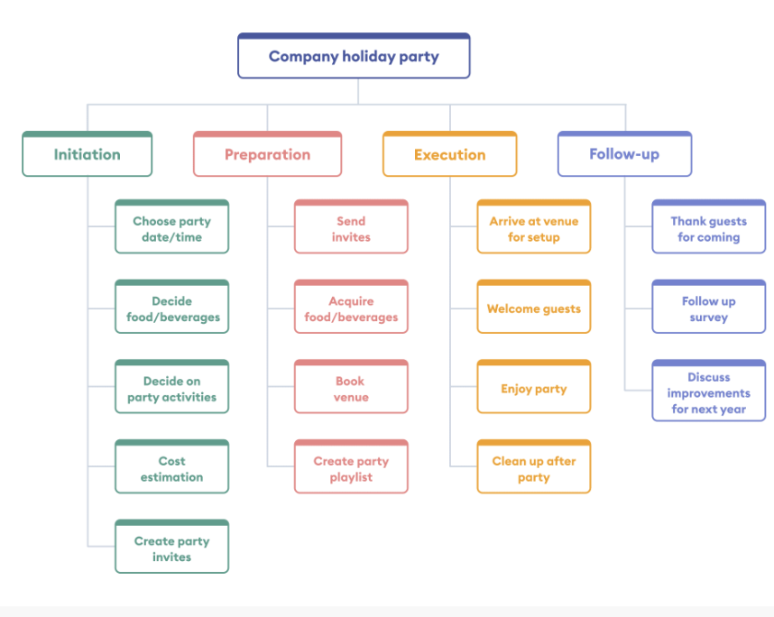
Work Breakdown Structure (WBS) is a way to rank tasks in the project. Begin with the project, then start breaking it down: first into phases and then from those milestones, into tasks. In a sense, you’re starting at the end of the project and working backwards. The breakdown is considering the size of the task, how long it will take and who will be responsible for that task.
Project Planning Tools
36
Notes:
Project management, we're essentially talking about a structured approach to completing tasks and achieving goals. And this structured approach can be broken down into four essential components.

Slide 37
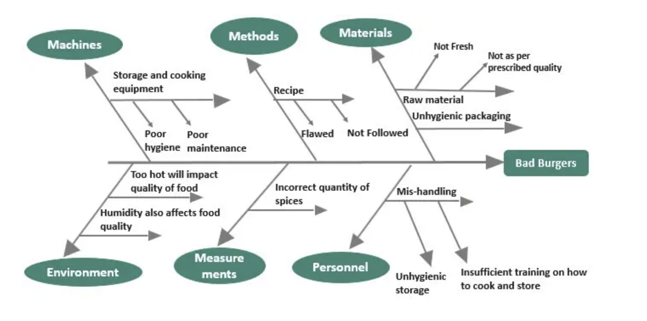
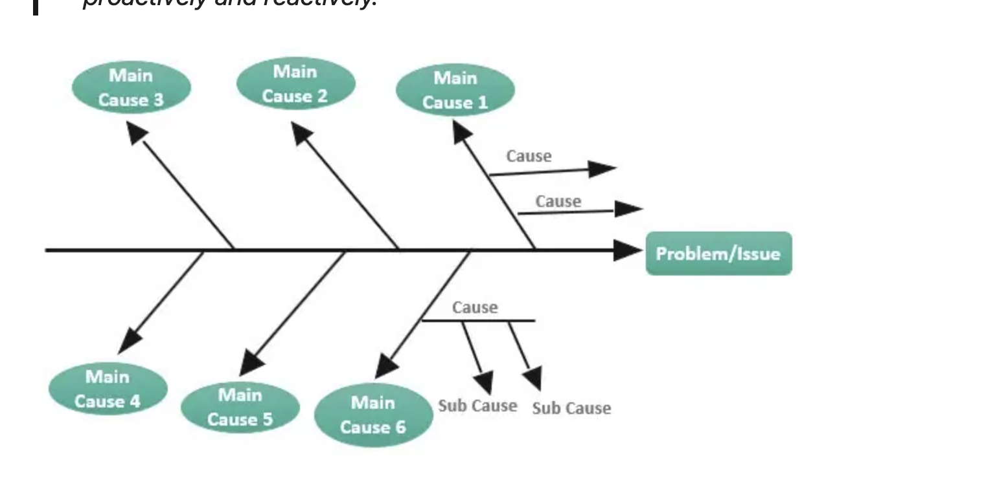
Cause and Effect Diagram(or Fishbone Diagram) It gathers and identifies issues that can develop over the course of a project. There is risk inherent in every project, and planning against those risks is another way to make sure the project proceeds as planned, without costly interruptions.
Project Planning Tools
37
Notes:
Project management, we're essentially talking about a structured approach to completing tasks and achieving goals. And this structured approach can be broken down into four essential components.

Slide 38

Notes:
https://jamesclear.com/continuous-improvement

Slide 39
“
By Failing to prepare, you are preparing to fail.
-Benjamin Franklin
Notes:
[Read slide]

Slide 40
QUESTIONS?

Slide 41
Managing Priorities
Notes:
We'll be talking mainly about external financing today.
But there are also internal sources to consider, the first and most important being sales.

Slide 42
“
I must govern the clock,
not be governed by it.
-Golda Meir
Notes:
[Read slide]

Slide 43
GOAL Setting
Goal setting is a process of identifying specific objectives that an individual or organization aims to achieve within a certain timeframe. It involves determining what you want to accomplish and establishing measurable goals and timeframes to guide your actions.
Make your Goals > SMART Goals
Understand the 'Why'
Break Down Large Goals
Incorporate Feedback and Accountability Mechanisms
Stay Flexible and Adapt
Consistent Tracking and Evaluation
Notes:
Make your Goals > SMART Goals
Understand the 'Why'> Clearly understand and articulate why each goal is important. This understanding fuels motivation and persistence, especially during challenging times.
Break Down Large Goals> Large goals can be overwhelming. Break them into smaller, more manageable tasks. This makes it easier to start taking action and track progress.
Incorporate Feedback Mechanisms> Establish ways to receive feedback on your progress. This could be through self-assessment, peer reviews, or regular check-ins if it's in an organizational context.
Stay Flexible and Adapt> Be ready to adjust your goals as circumstances change. Flexibility is key to staying relevant and realistic in your goal-setting process.
Consistent Tracking and Evaluation> Regularly monitor and evaluate your progress towards your goals. This tracking helps in identifying areas where you are excelling and areas that require more focus or adjustment.

Slide 44
Prioritizing
Prioritization is about deciding what's important. Focus is about allocating a disproportionate share of your attention and resources toward the priority.
Notes:
Strictly speaking, fundraising is [read definition].
It's a simple concept
And who will provide the funding you need to succeed?

Slide 45
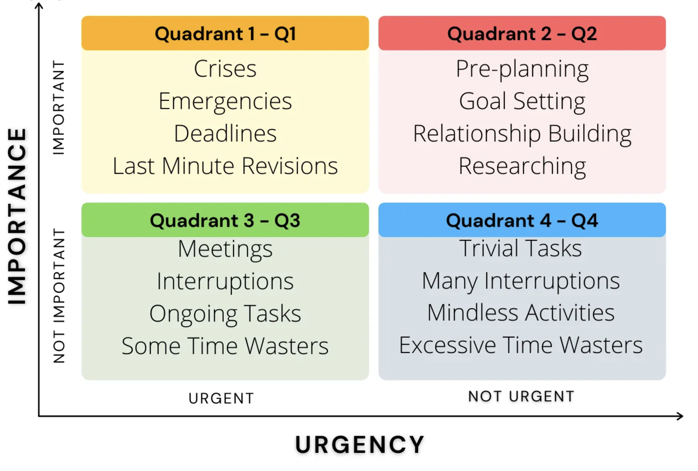
Prioritization
Time Management Matrix (quadrant system) or Eisenhower Matrix
Helps prioritize tasks and activities in a startup context.
Emphasize the importance of focusing on high-impact, strategic tasks.
Notes:
[Read slide]

Slide 46
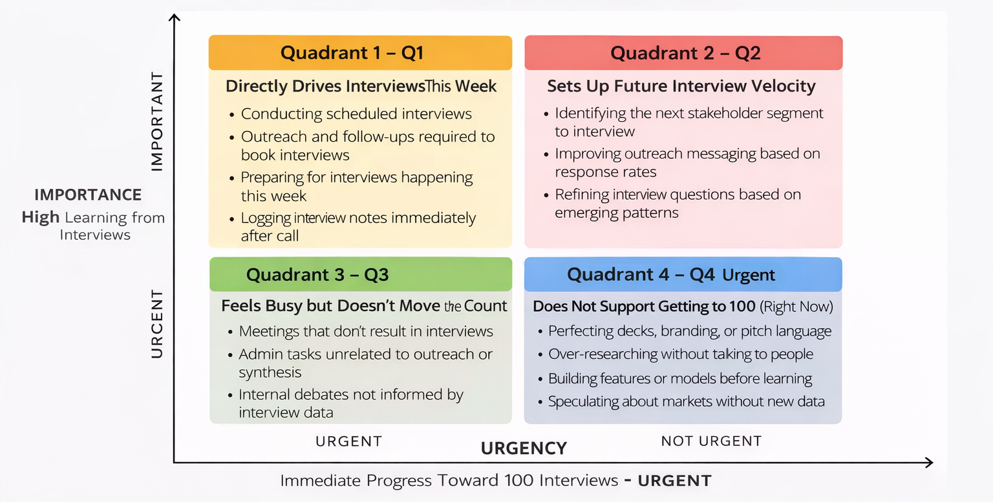
Prioritization – What Gets You to 100?
If it doesn’t help you book, run, or learn from interviews, it must be consciously limited.
NOT IMPORTANT
Notes:
[Read slide]

Slide 47
QUESTIONS?

Slide 48
For Next Week
Set up our Customer Discovery Strategy
Set up your Customer Discovery Tool (and Share with your Facilitator)
Get familiar with Air Table
Re-watch ‘How to Get Interviews’ on Notion
Notes:
[Read slide]

Slide 49
THANK YOU

